Slide 1
Computing:
past, present and future
Lesson 2: Designing a leaflet

Slide 2
Objectives
In this lesson, you will learn:
how to use a range of word-processing tools
about the design cycle
how to create a well-designed leaflet using word processing software

Slide 3

Word-processing applications today
The first commercial word processing application, WordStar, published in 1978.
Compared with WordStar, modern word-processing applications are incredibly feature rich.
Yet, in spite of all these new features, modern word-processing applications perform much the same functions as the very first word processor: you enter and format text and save and retrieve electronic documents.
Microsoft Word and Google Docs are the most popular word-processing software applications in the world.

Slide 4








The most commonly used word-processing commands
Font and font size
Undo typing
Copy and paste
Save
Bold
Align to Left, Centre text, Align to Right and Justify text
Print
Bulletpoints

Slide 5

What to do if you don’t know what to do
The user interface (UI) of word-processing applications have been designed so that they are intuitive; so that they are easy to use and understand.
For this reason, we are not going to teach you how to use Word or Google Docs.
Instead, we are going to teach how to work out how to do things yourselves.

Slide 6
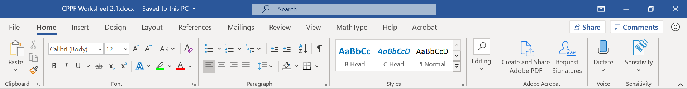
The ribbon across the top of the application gives you access a vast array of features, so the first thing you need to do is investigate what the application has to offer.
Place your mouse over the icons on the toolbars for more information.
Try to find things out for yourself. Be prepared to experiment.
If you need help, use the application’s built in Help feature.
If you're really stuck, find an online tutorial.

Slide 7

Activity 2.1: Word-processing skills

Slide 8
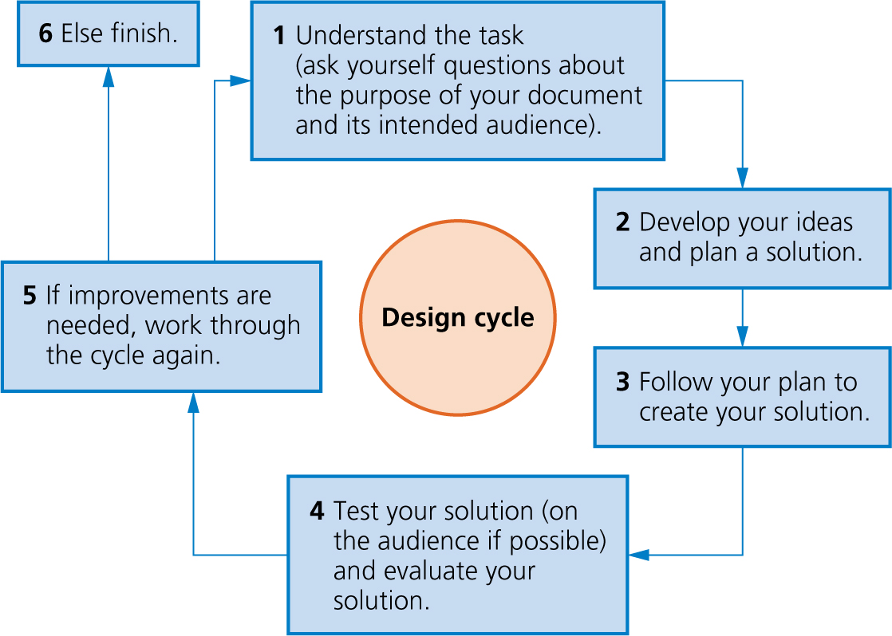
The design cycle

Slide 9
Activity 2.2: Planning and creating a leaflet

Slide 10
Activity 2.3: Commenting on your partner’s leaflet
Swap computers with a partner and use the comments tool to give feedback on the design of your partner’s leaflet.
In Microsoft Word, highlight the word or phrase you want to comment on, then click on ‘Review’ and ‘New comment’.
In Google Docs, highlight the word or phrase you want to comment on, then click on the ‘Add comment’ icon in the toolbar or the ‘Add comment’ icon on the right of the page.
Remember to save your partner’s document when you have finished adding your comments.

Slide 11
Quiz 2

Slide 12
Activity 2.4: Finishing creating your leaflet
Evaluate the feedback you received on your leaflet and, if necessary, make improvements.
Remember to 'Save as' before you begin making improvements, so you always have your partner's comments to refer back to.

